Slide 1
PCF 2.2 Technical Overview
[speaker name]
[date]

Slide 2
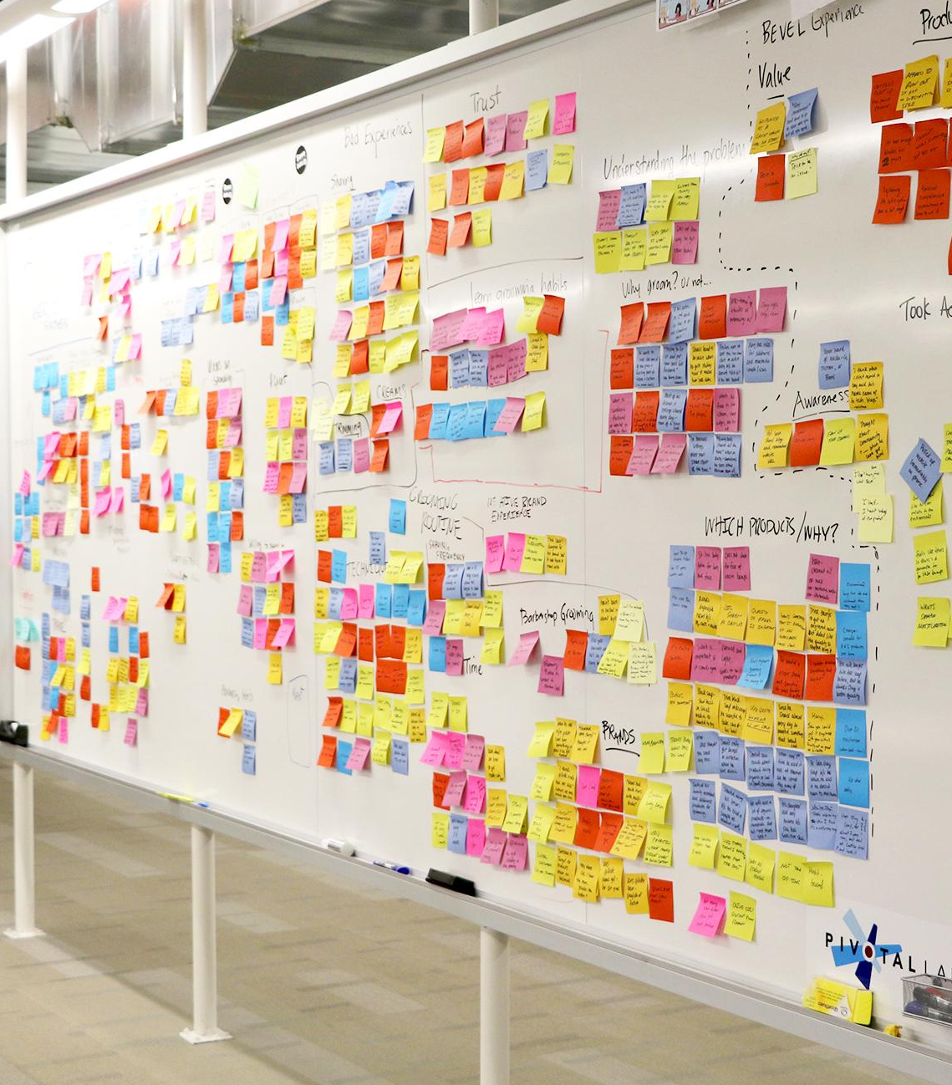
Agenda
Level Set + Value Proposition
Platform Evolution
Pivotal Cloud Foundry Overview
New Feature Summary

Slide 3
Level Set
What are you trying to accomplish?
Any noteworthy milestones and dates?
What decisions have already been made?
Notes:
Let’s do a quick level set here -
The first thing we need to do is define our goals. An example might to deliver a cloud strategy and reference application, or it may simply be to get a particular set of new or existing applications onto a stable and secure environment in the cloud.
While doing this, we need to keep in mind the both the dates we expect to hit, as well as milestone markers we should track to. For example, standing up an environment, establishing a CI/CD set of best practices, and pushing a reference application could be considered as milestones.
Finally, we need to consider all decisions regarding strategy and product that have already been made. In addition to product decisions around core application development and platform, decisions around monitoring and metrics, security, analytics, and a host of other areas will play into how you move forward.
With all of this in mind, we can determine what the solution needs to look like and where we can leverage what we have already.

Slide 4
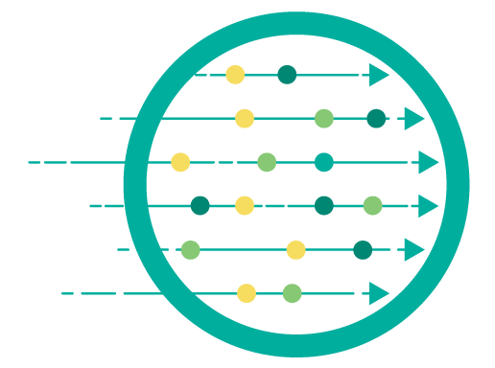


Typical Customer Outcomes with Pivotal Cloud Foundry
Speed
Deploy new code thousands of times a month
Best platform for Spring Boot
Container-ready
Native Windows + .NET
Full integrated with CI/CD
Stability + Scalability
Deliver enterprise SLAs and breakthrough operational efficiency
Four layers of HA
Zero downtime deployments
Logging, metrics, and scaling
Linux + Windows Server
Security
Improve your security posture with built-in capabilities
“Secure by default” containers
Full-stack support
Rapid fixes to CVEs
“Repair, repave, rotate”
HIGHLIGHTS
HIGHLIGHTS
HIGHLIGHTS
Notes:
Let’s talk about what we are trying to achieve here. The core value proposition of Pivotal Cloud Foundry covers these three primary areas:
When it comes to speed, we are talking about time to market. To be agile instead of waterfall means more feedback earlier in the development cycle, thus higher quality code and more relevant features. The combination of support for all modern languages and our support and standardization for native Windows development is a game changer, as it drastically reduces the complexity when it comes to production deployments. And since Cloud Foundry plays well in a continuous integration and delivery environment, all of the pieces are in place for getting from idea to production quickly.
A system or platform is only as good as its weakest link. Pivotal Cloud Foundry ensures that all components of the platform, as well as deployed services and applications, support both zero downtime deployments and have 4 layers of HA. These layers are 1) Across Availability Zones, 2) All Virtual Machines, 3) Platform Components, and 4) Application Instances. When you add consistent scalability across almost limitless resource pools (public cloud), along with built-in automatic metrics and monitoring, Pivotal Cloud Foundry shines at scale.
And most important in today’s complex world is security throughout. Repeating the weakest link metaphor, we must ensure that everything is secure by default. By prescribing the correct paths to access the platform, hosted applications, and built-in services, Cloud Foundry can effectively lock itself down with the minimum number of entry points required to function. And by following the 3 Rs methodology, which essentially says that it is easier and safer to re-pave and rotate than to maintain and bolt on, Cloud Foundry ensures both the most secure platform at all levels, as well as the ability to respond and close down threats faster and with the lowest impact on production.

Slide 5
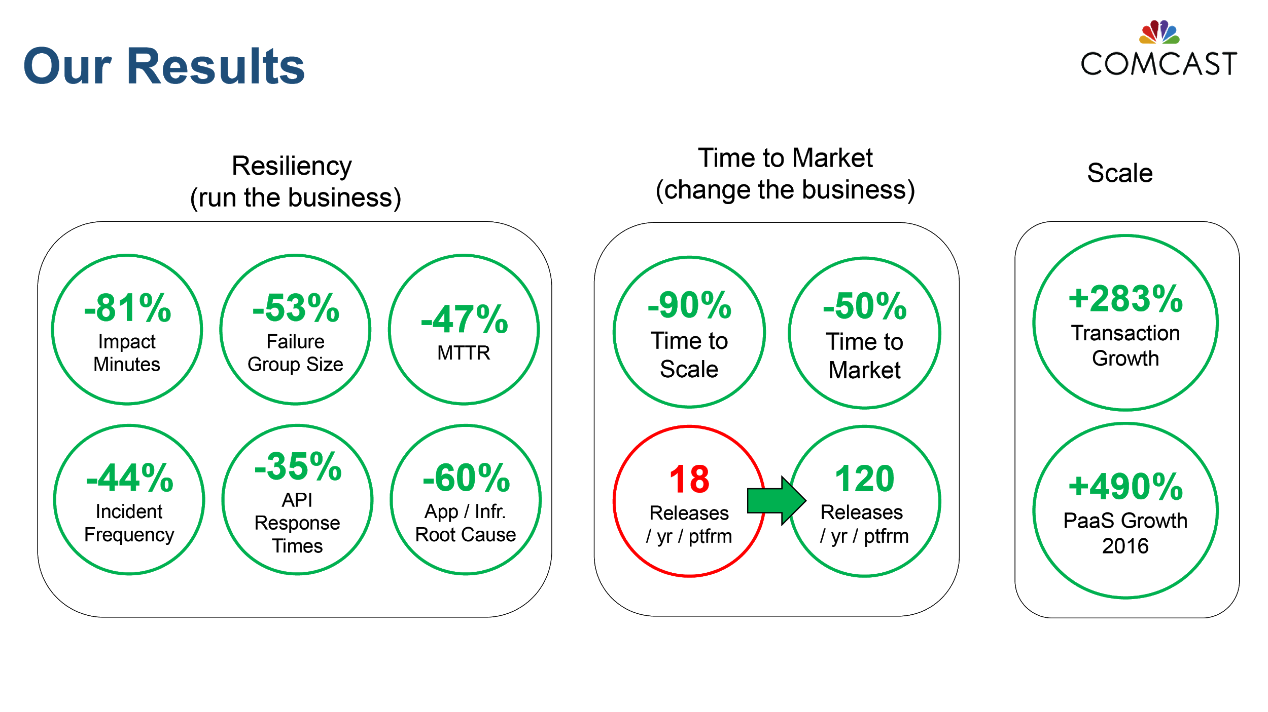
Comcast: Stability, Speed, Scalability with PCF
1,500+ Developers
5,000+ Applications
4-6 Operators
210M Daily Transactions
2X Faster Time to Market
80% Better Resiliency
10X Faster to Scale
25% ‘Oxygen’ increase
Source: Greg Otto, Executive Director, Cloud Services at Comcast, CF Summit June 2017
Notes:
Comcast moved from Oracle JEE to microservices framework using Spring Boot and Cloud, continuous delivery pipelines with Concourse (and Jenkins), Pivotal Cloud Foundry and DevOps
Comcast talk Replay: https://youtu.be/pfqSsjwCOqA

Slide 6
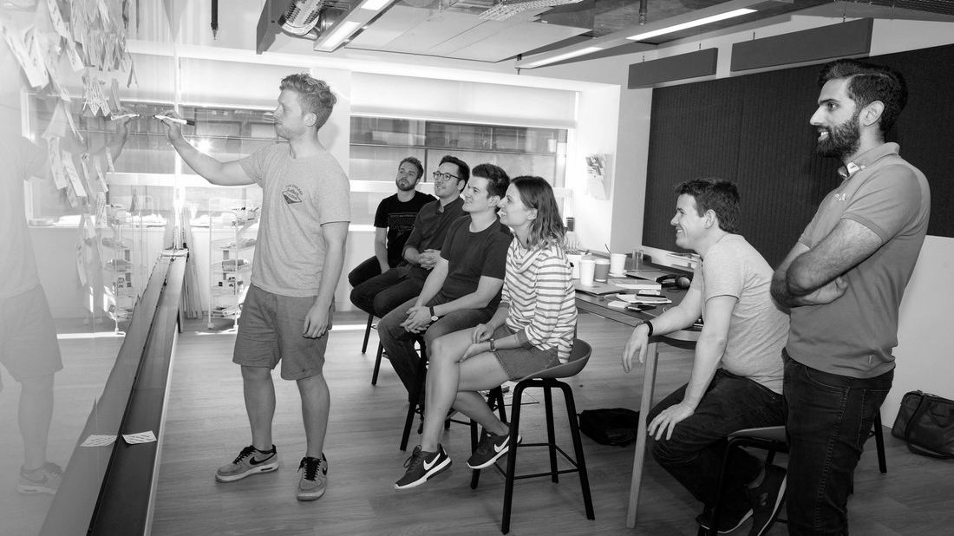
Platform Evolution

Slide 7
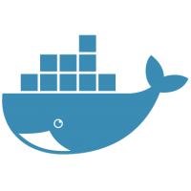
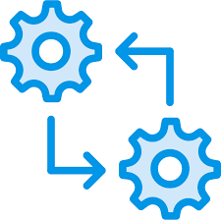


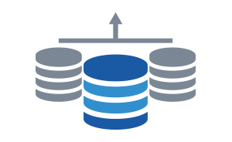

There are many ways to package and run
workloads in the cloud
Containers
Batches
Event-driven Functions
Microservices
Data Services
Monolithic Applications
Notes:
It is important to understand that workloads have, and always will, come in many shapes and sizes. Moving to the cloud does not change this fact - therefore any viable cloud-based solution must provide mechanisms to run workloads that vary. Starting with existing monolithic applications that are highly customized, cloud providers must offer methods to deploy everything from containers to serverless functions. We’ll get into the details about how Pivotal Cloud Foundry specifically addresses each.

Slide 8
Your goal: choose the right runtime for each workload
Containers
Batches
Event-driven Functions
Microservices
Data Services
Monolithic Applications
Container
Orchestrator (CaaS)
Application Platform
(PaaS)
Serverless Functions
(FaaS)
IaaS
Notes:
What we first want to do is define the major types of “as-a-service” paradigms, and then we can talk about what we offer. A couple of points:
Container Orchestration focuses on allowing organizations to package applications with some level of customizations, but with an agreed upon line of demarcation between what the infrastructure provides, and what the packaging of the application must provide.
Application Platforms, such as Pivotal Cloud Foundry, should provide everything required to build and run a complex system of interconnected microservices and containers. Orchestration, metrics, scalability, and all other “-ilities” should be provided. The end game here is to give developers a place to safely deploy applications in a consistent manner.
Serverless Functions refer to the ability to put a single set of reusable actions into an ephemeral container, and then host that independently from other components in the datacenter.

Slide 9
Choose the right tool for the job
Container
Orchestrator
Application Platform
Serverless Functions
Developer
Provides
CONTAINER
APPLICATION
FUNCTION
Tool
Provides
Container Scheduling
Primitives for Network, Routing, Logs & Metrics
Container Orchestrator
Container Orchestrator
Container Image & build
L7 Network & Routing
Logs, Metrics, Monitoring
Services Marketplace
Team, Quotas & Usage
Function execution
Function scaling
Event stream bindings
IaaS
Notes:
Each tool has its own purpose. We should be careful that we articulate the value each tool brings to the table and what it’s strengths and weaknesses are. We need to make sure to point out that as you move “up the stack” from Containers to Serverless, you have less control, but you have less that you are responsible for as well. Users need to make sure they’re picking the right tool for the job they need to accomplish.
Examples:
If you need to be able to run your application on a specific port, or need to co-mingle a couple applications right next to each other, then a Container Orchestrator (PKS) is a great solution.
If you have a webapp that runs without any heroic efforts to change from running on your laptop to production, then an Application Platform (PAS) is a great solution.
If you have a piece of code that needs to run when some event happens, instead of deploying an application with a very limited scope of work, consider writing that functionality to run as a Function as a Service and deploy to a Serverless Infrastructure (PFS)

Slide 10
Use the highest abstraction possible
Serverless Functions
Application Platform
Higher flexibility and less enforcement of standards
Lower development complexity and higher operational efficiency
Container Orchestrator
IaaS
Hardware
Your strategic goal: Push as many workloads as technically feasible to the top of the platform hierarchy
Notes:
The more you can let platforms take over responsibility for running your applications, the more free time you’ll have to add new functionality to those applications.
Whenever you build new application functionality, you should ask yourself “what do you want to manage going forward?” Do you want to have to manage an VM, a container, or just deploy a function?
The further up the stack you can keep your applications, the less overall plumbing you need to worry about maintaining in the future.

Slide 11

Application Code & Frameworks
Buildpacks | Spring Boot | Spring Cloud | Steeltoe
Continuous
delivery
Github
Public Cloud Services
Pivotal Network
Open Service Broker API
Pivotal Application Service (PAS)
Pivotal Container Service (PKS)
Pivotal Services Marketplace
Customer Managed Services
Concourse
>cf push
>kubectl run
Pivotal and
Partner Products
v1
CVEs
Product Updates
Java | .NET | NodeJS
Elastic | Packaged Software | Spark
v2
“3Rs”
v3
Embedded OS
(Windows & Linux)
NSX-T
Repair
— CVEs
Repave
Rotate
— Credhub
...
Concourse
CPI (15 methods)
vSphere
Openstack
AWS
Google Cloud
Azure & Azure Stack

Slide 12
WE build the container
YOU build the container
Application Code & Frameworks
Buildpacks | Spring Boot | Spring Cloud | Steeltoe
Continuous
delivery
Github
Public Cloud Services
Pivotal Network
Open Service Broker API
Pivotal Application Service (PAS)
Pivotal Container Service (PKS)
Pivotal Function Service (PFS)
Pivotal Services Marketplace
Customer Managed Services
Concourse
> cf push
> kubectl run
> riff function create
Pivotal and
Partner Products
v1
CVEs
Product Updates
Java | .NET | NodeJS
Elastic | Packaged Software | Spark
v2
“3Rs”
v3
Embedded OS
(Windows & Linux)
NSX-T
Repair
— CVEs
Repave
Rotate
— Credhub
...
Concourse
CPI (15 methods)
vSphere
Openstack
AWS
Google Cloud
Azure & Azure Stack

Slide 13
Leveraging more than one abstraction
Pivotal Application Service (PAS)
Pivotal Container Service (PKS)
GCP Service Broker
Application
Application
Kubernetes
PKS Controller
K8s Cluster
NSX-T
K8s Cluster
K8s Cluster
Platform Services
Other
Broker
Services
Harbor
Logging
Metrics
Monitoring
BOSH
VMware
GCP
Azure
Openstack
AWS
Notes:
Every workload is different. By having a choice where to deploy, we give developers the freedom to choose the level of abstraction that is appropriate for the application they are deploying.

Slide 14
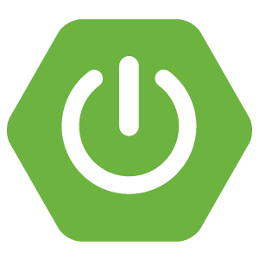

Sample Use Case
Pivotal Application Service (PAS)
Pivotal Container Service (PKS)
GCP Service Broker
Kubernetes
Spring Boot App
Spring Boot App
PKS Controller
K8s Cluster
NSX-T
K8s Cluster
Platform Services
Other
Broker
Services
Harbor
Elastic Search
Logging
Metrics
Monitoring
BOSH
VMware
GCP
Azure
Openstack
AWS
Notes:
In this example, we have a Spring Boot app that needs a service running on PKS, which in this case is Elastic Search. This is powerful in showing that developers have even more self-service options available to them if they can run development data services in PKS without having to request new resources via tickets.
We should also point out that this allow developers to break up their applications more logically now as well and run part of their applications in PAS and other in PKS as appropriate.

Slide 15

Pivotal Cloud Foundry Overview

Slide 16
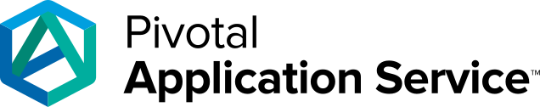
Pivotal Application Service (PAS): A Runtime for Apps
Best runtime for Spring and Spring Boot — Spring’s microservice patterns—and Spring Boot’s executable jars—are ready-made for PAS.
Turnkey microservices operations and security — Spring Cloud Services brings microservices best practices to PAS. It includes Config Server, Service Registry, and Circuit Breaker Dashboard.
A native Windows and .NET experience — Use PAS to run new apps built with .NET Core. Run your legacy .NET Framework apps on PAS too, using the .NET Hosted Web Core buildpack. Push applications to containers running on Windows Server 2016.
Built for apps — PAS has everything to need to run apps. Buildpacks manage runtime dependencies; metrics, logging, and scaling are done for you. Multitenancy, and blue/green deployment patterns are built-in. Extend apps with a rich service catalog.
Container-ready — PAS supports the OCI format for Docker images. Run platform-built and developer-built containers.
Increase speed and deploy code to production thousands of times per month. Use PAS to run Java, .NET, and Node apps.
Notes:
Pivotal Application Service (or PAS, formerly Elastic Runtime or ERT) sits at the core of what Pivotal offers. As Pivotal’s Platform as a Service (PaaS) offering, it delivers on the promises of Microservices & DevOps at scale in many ways:
It provides the best place for Spring and Spring Boot applications to run. Many other popular languages are fully supported with native buildpacks - NodeJS, Python, PHP, Ruby, Go, .Net just to name a few.
PAS was built for microservices, and natively integrates with many of the patterns that are necessary to use microservices at scale. Spring Cloud Services introduces a production-ready implementation of these patterns, and can be deployed on PAS quickly.
PAS offers a native Windows experience that can run both new and legacy .NET applications, with the same platform-level features as Linux-based applications. We like to use the term polyglot to refer to multiple languages, and by running multiple OSes under the covers, PAS allows for true polyplatform and polyglot deployments.
Surrounding every application and service is a full ecosystem of management, monitoring, logging, scaling, and related services. These enable you to go from simple applications deployed in one container to 100s or 1000s of applications and services working together to comprise real enterprise applications, at a significant savings in every IT cost center.
And last, as part of supporting multiple ways to deploy and manage applications, we support Docker as a first-class citizen. You can easily run and create public and private images, hosted publicly or privately.

Slide 17
Built with open-source Kubernetes — Constant compatibility with the current stable release of Kubernetes, operated by BOSH. No proprietary extensions.
Production-ready — Highly available from apps to infrastructure, no single points of failure. Built-in health checks, scaling, auto-healing and rolling upgrades.
Multicloud — BOSH provides a reliable and consistent operational experience. For any cloud.
Network management and security out-of-the-box with VMware NSX-T. Multi-cloud, multi-hypervisor.
GCP APIs access — The GCP Service Broker allows apps to transparently access Google Cloud APIs, from anywhere. Easily move workloads to/from Google Container Engine (GKE).
Fully automated Ops — Fully automated deploy, scale, patch, upgrade. No downtime. Use CD pipelines to deploy your platform, too.
GCP Service Broker
Kubernetes
K8s Cluster
K8s Cluster
PKS Controller
K8s Cluster
NSX-T
Harbor
BOSH
VMware
GCP
Azure
Openstack
AWS
Notes:
For this slide, pick a couple of the bullet points to discuss:
Open Source K8s -- The Kubernetes runtime is a proven solution, and we do not want to add anything proprietary on top of it. What we do is track to the latest stable release, and test BOSH management of the K8s stack, which comprises the core of PKS
Production Ready -- By default applications can be deployed to K8s with no SPOF. All of the characteristics of production readiness are there from the start - automatic scaling (up or down), rolling upgrades, application health checks, and more.
Multi-cloud -- BOSH, through the Cloud Provider Interface, offers the ability to truly run on any cloud, with the same experience. This takes vendor lock-in off the table from the start. It also can insure against major outages with a single provider by allowing duplicate deployments on multiple providers.
Network Management -- Using NSX-T we have the capability to allow you to define and manage the container networking environment to go with a deployment. This is likely to avoid much of the configuration work that involves other teams, and it allows the developers and designers to control the networking that will be available to the application in the way that the application requires.

Slide 18
Pivotal Container Service (PKS): A Runtime for Containers
Kubernetes Dial Tone:
Health management
Aggregated Metrics and Logging
Autoscaling
Persistence interface
Control Plane:
Provisioning Engine
T-shirt sized clusters
Self-service Clusters
Software Update Automation
Load balancing
Networking
Multi-tenancy
A turnkey solution to provision, operate and manage enterprise grade Kubernetes clusters
+
+
Notes:
Container as a service (or CaaS) gives you more flexibility to control a complex system of moving parts. Typically this is done through containers running on a container runtime, and in our case that is Kubernetes. What PKS adds is the BOSH management layer, NSX-T for container networking, and the PKS controller to deploy and manage K8s pods along with the rest of your applications and functions.

Slide 19
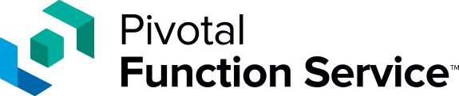
Pivotal Function Service (PFS): A Runtime for Functions
Trigger functions via HTTP/Message Broker — With PFS, you can quickly set up functions for a variety of events. PFS is architected to support pub/sub message delivery over messaging channels.
Run functions anywhere — PFS lets you easily run functions on-premises and in the public cloud for maximum flexibility.
Built on Knative — PFS is built on Knative, an open-source project led by Google. Knative simplifies how developers deploy functions atop Kubernetes and Istio.
Pluggable build system — PFS features a source-to-container mechanism to simplify deployment. Use proven components like Cloud Foundry Buildpacks.
Pluggable event sources — PFS Event Sources facilitate the creation of Feeds from a variety of external event sources such GitHub webhooks, blob stores, and database services.
Pluggable event brokers — PFS can be connected easily with popular message brokers such as Kafka, Google Pub/Sub, and RabbitMQ.
Execute functions in response to events. Use PFS to handle web events, event-based integration, and large scale streaming data.
Notes:
Function as a service (or FaaS) will allow for the highest level of abstraction, as we talked about earlier. Individual operations can now be considered discrete entities, and can be managed and scaled independently. Pivotal Function Service (or PFS) will fulfill this promise, and do so with the same core management and monitoring across the platform as Pivotal Application and Container service.

Slide 20
PFS Scenarios & Use Cases
Web Events
Event-based Integration
Stream
Processing
Website back-end services like form post handlers, authentication, tracking and logging.
APIs to back-end data services for mobile and web apps e.g GraphQL
Webhook handlers
Chat integrations
Digital assistant services e.g. Alexa skills
Scheduled tasks, data integration
File processing e.g. images and videos
Security scanning
Complex Event Processing and Change Data Capture
Monitoring, notifications and alerting
Custom auth e.g. via API Gateway
IoT streams
Log ingestion
Event streams e.g. with Kinesis
ML pipelines
Notes:
Without going into specifics here, the types of workloads that for for PFS are here. One common theme here is that repetitive and often short-lived tasks might be better served when executed on their own, and not within the context of a larger applications. Functions could also take a role in breaking apart monolithic applications, by providing a runtime environment in which to break off functionality in a safe space. And because PFS is ultimately managed by BOSH, it will exhibit the same enterprise reliability and manageability as the rest of the Pivotal Cloud Foundry products.

Slide 21
App Platforms + Functions
App Platform Abstraction | Functions Abstraction
runs apps | runs functions
push app to deploy server | register function and bind it to a trigger
server runs and waits for requests | function doesn't run until triggered
server listens to network | platform deploys and invokes functions
server handles lots of requests | functions handle events and then go away
scale out manually or by policy | auto-scale based on concurrent event load
pay per instance | pay per use – time & memory
Comparing the experience for Devs + Ops
Notes:
In this slide, pick a couple of these for comparison - it will be quickly obvious that functions and applications differ.

Slide 22
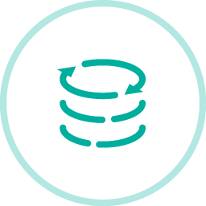
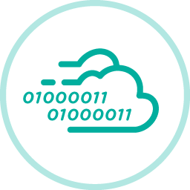

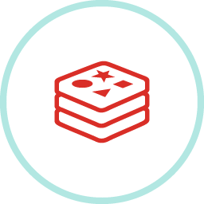
Extend Apps with Brokered Services from Pivotal
MySQL for PCF
Pivotal Cloud Cache
RabbitMQ for PCF
Redis for PCF
Enterprise-ready MySQL for your developers
Automate database operations in developer workflows
Leader-follower for multi-site HA
NEW: TLS encryption
High performance, in-memory, data at scale for microservices Look-aside caches & HTTP session state caching
WAN replication
NEW: Connect more than two clusters via WAN
Easily connect distributed applications with the most widely deployed open source message broker
Enable connected scalable, distributed applications
NEW: TLS encryption
In-Memory cache and datastore, configured for the enterprise
Efficient provisioning matched to use cases
NEW: Backup and restore integration
BOSH Managed | On-Demand Provisioning | Dedicated Instances | Custom Service Plans
Notes:
Managed (or brokered) services from Pivotal give customers enterprise-grade reliability for backing services that typically support your applications. Pivotal curates and release these services in a way that employs BOSH to manage their lifecycle in the same way that manages applications. And by requiring administrators to create tee shirt sized service plans, there is less to do from an application standpoint.

Slide 23
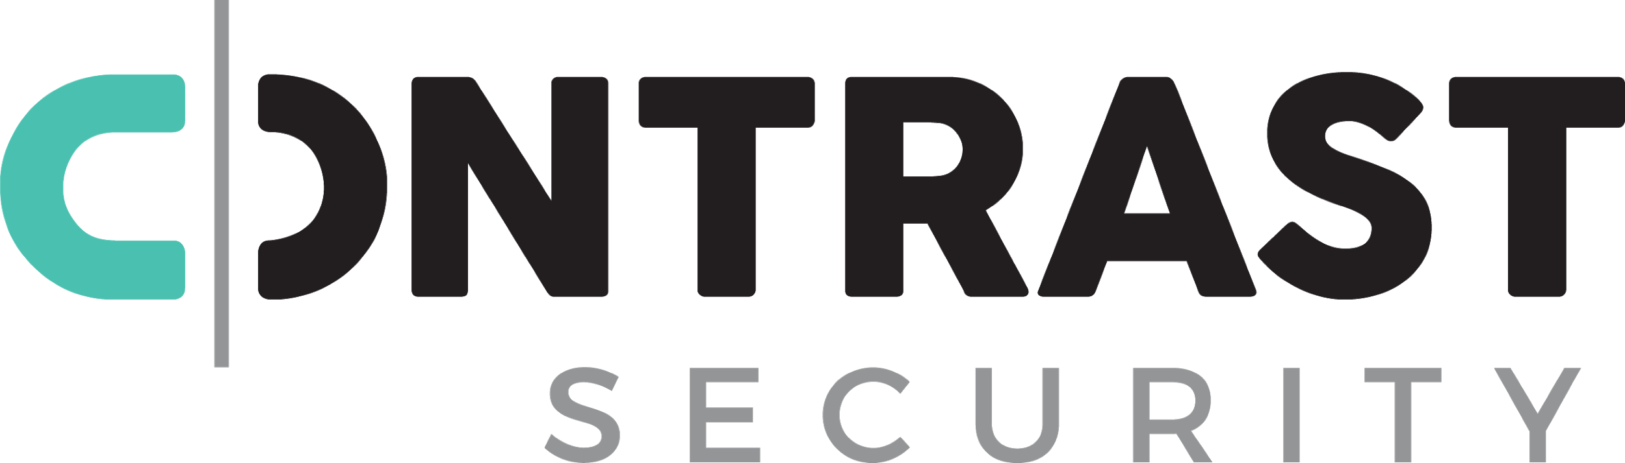

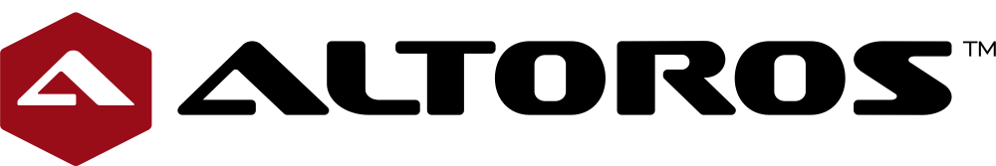
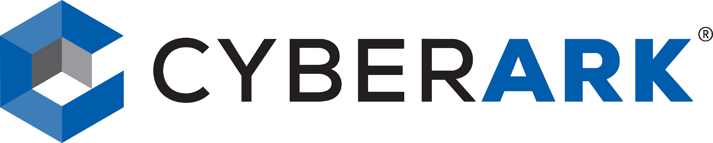
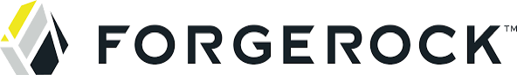
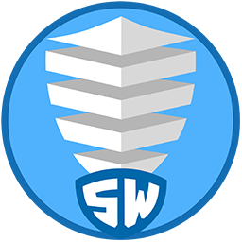
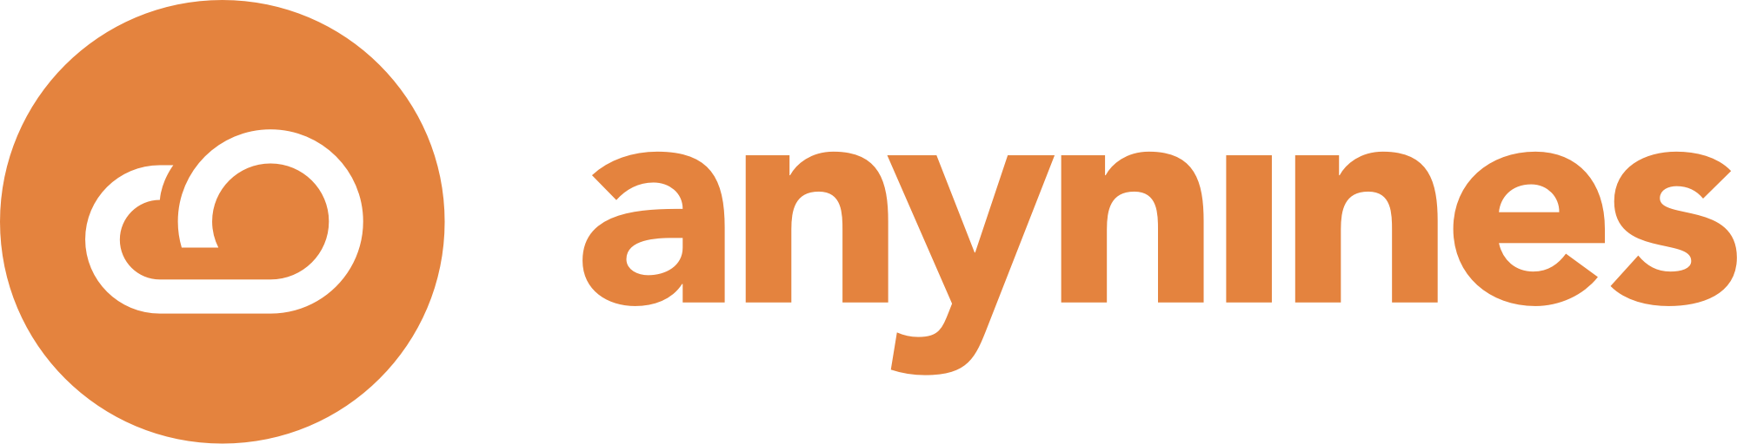
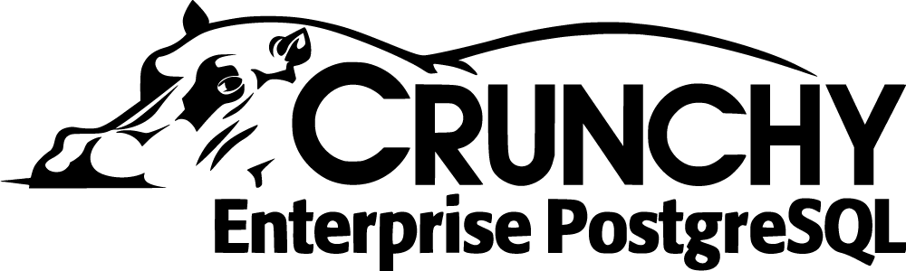

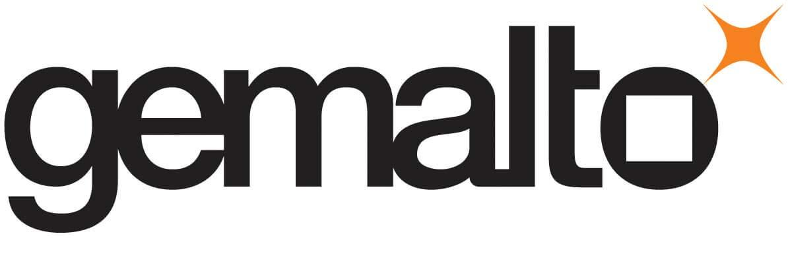
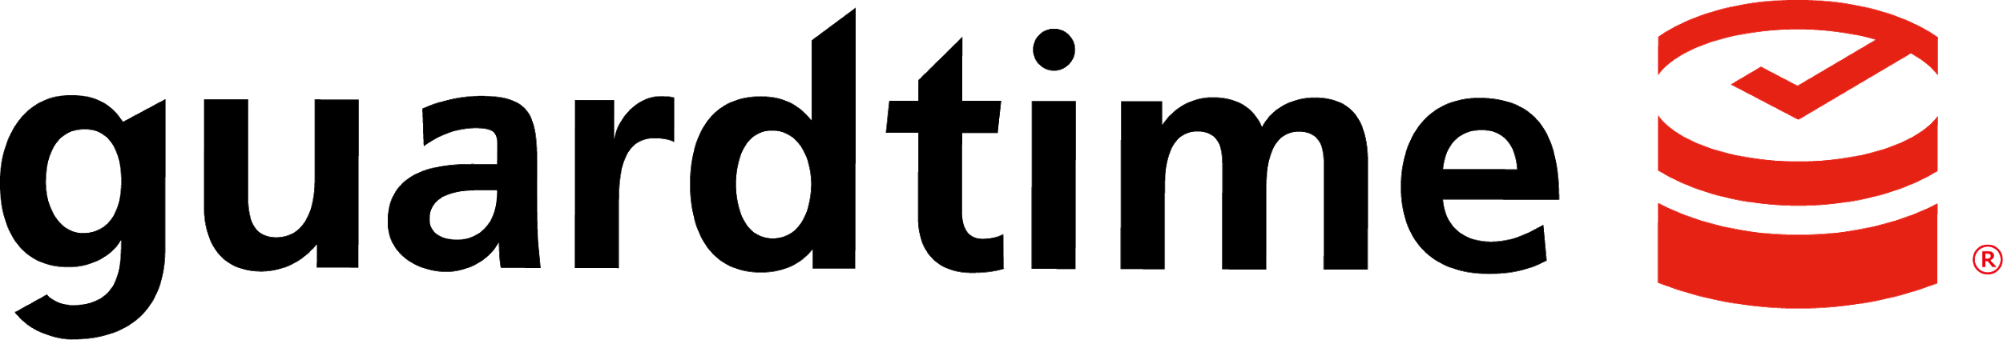

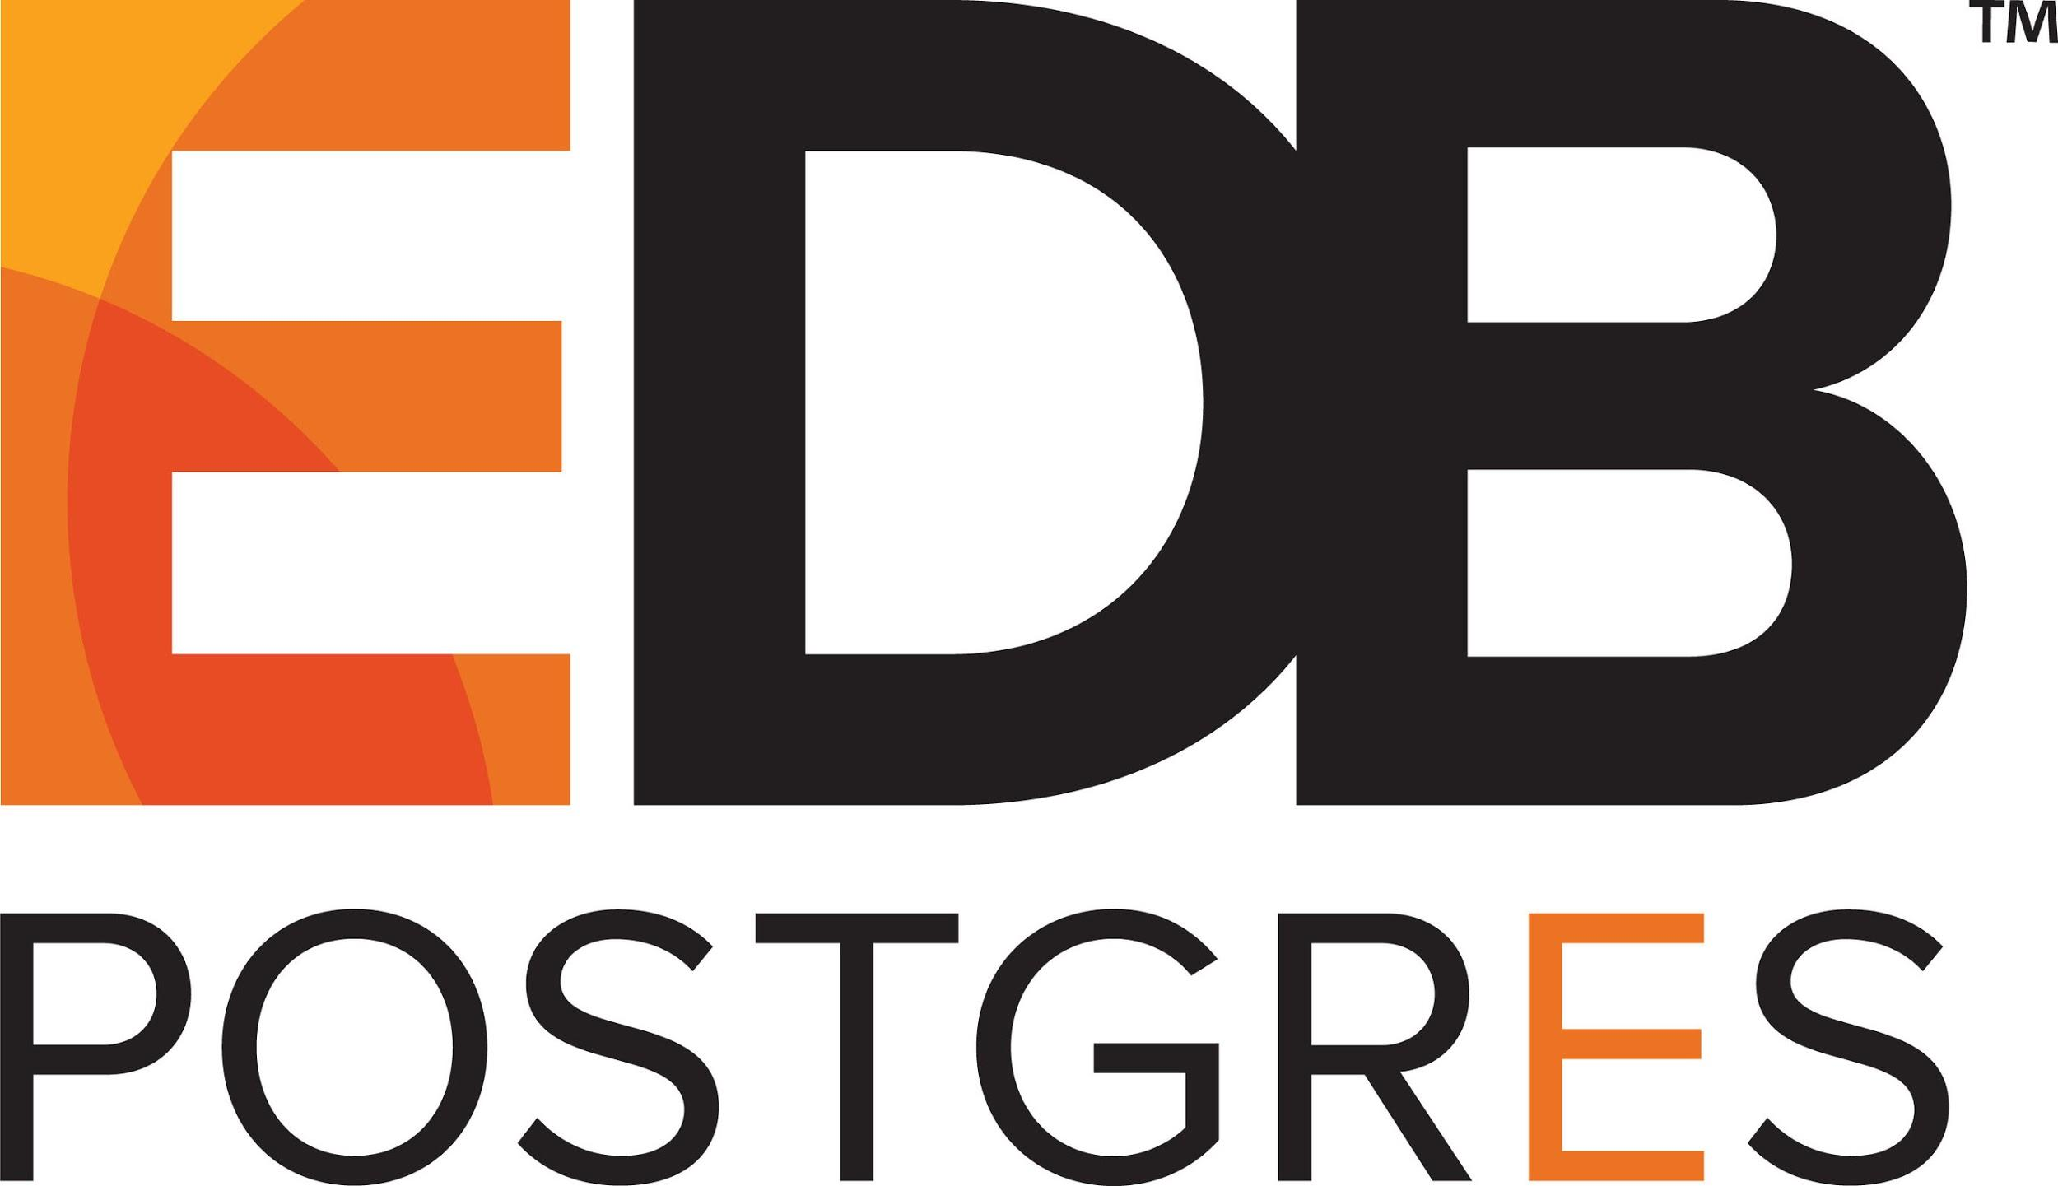

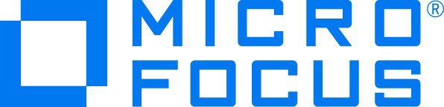


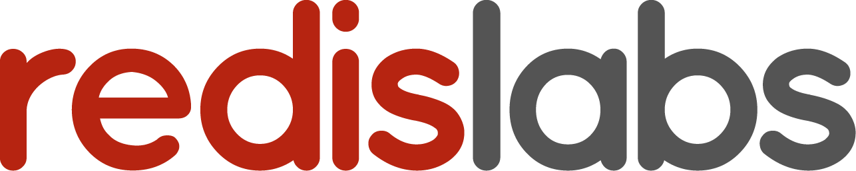
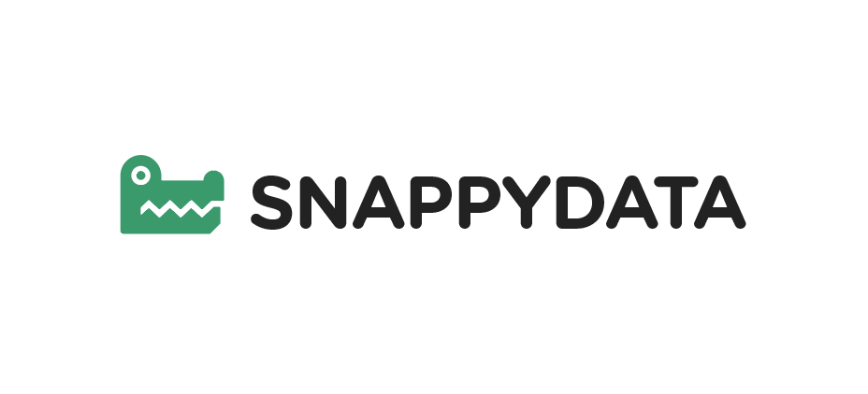
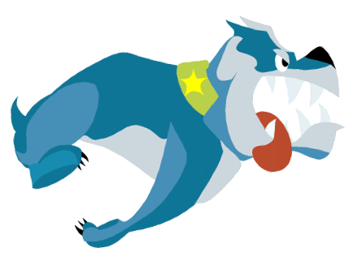
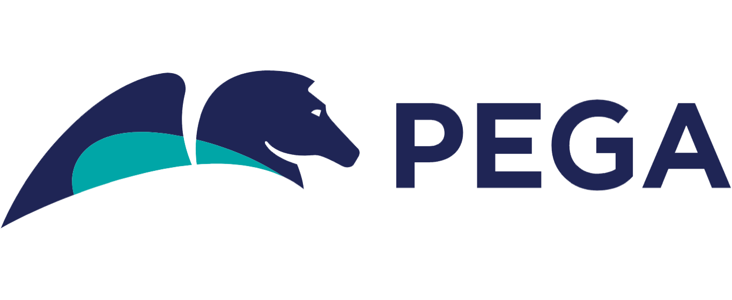


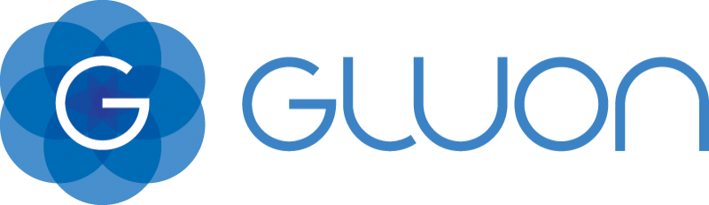

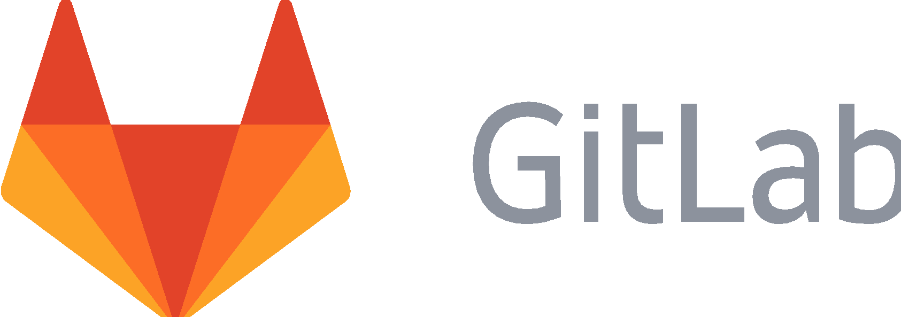
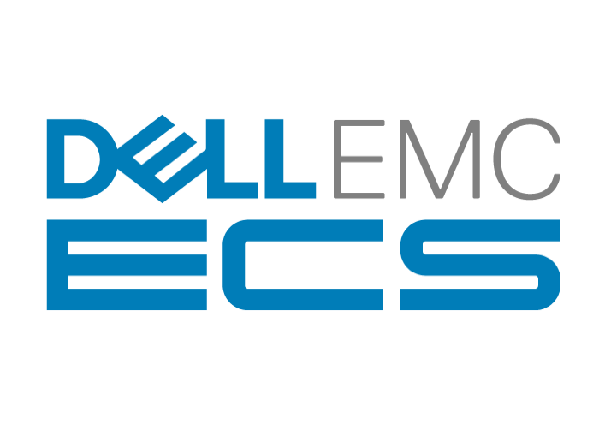

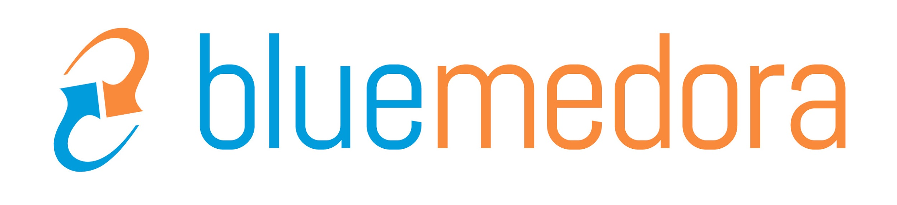
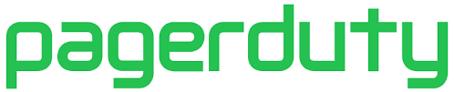
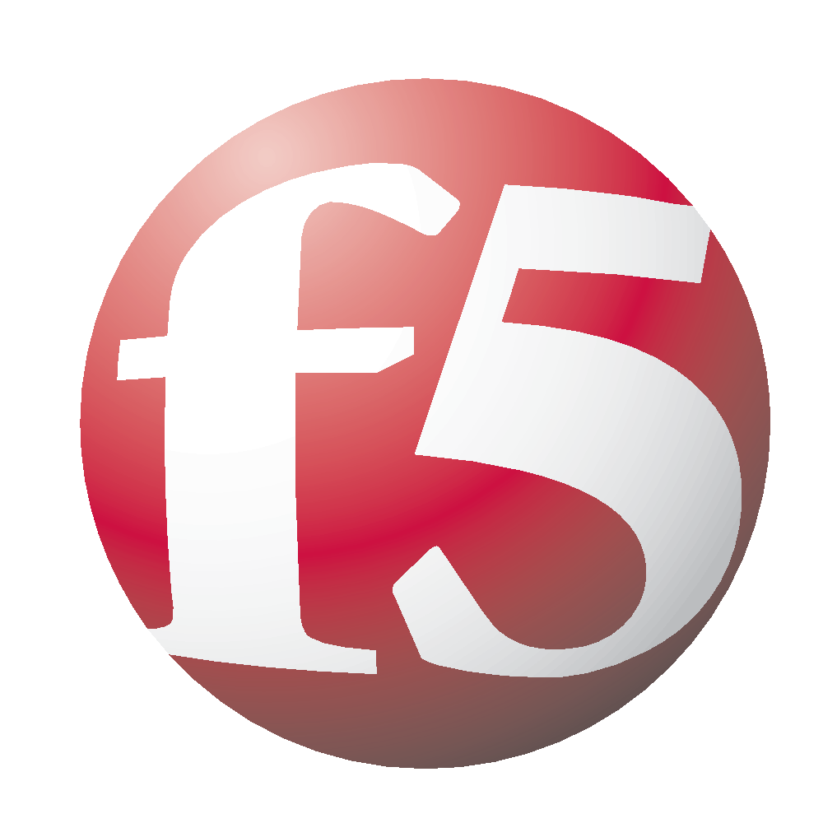
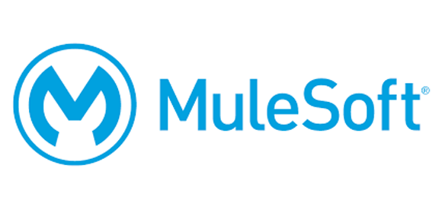
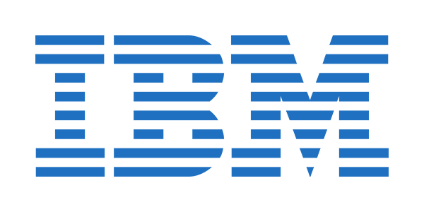
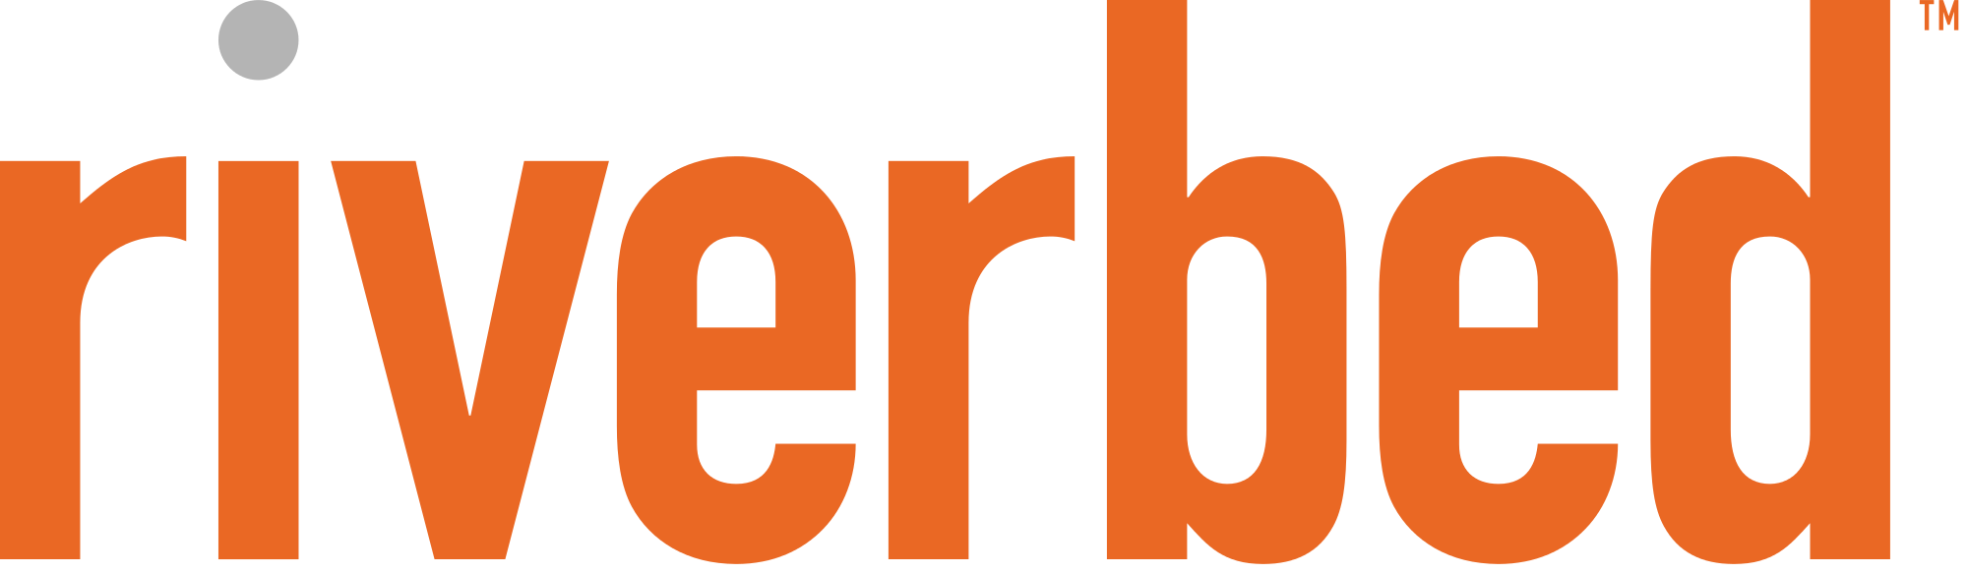
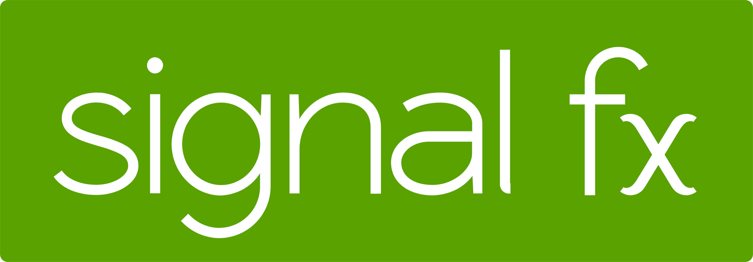
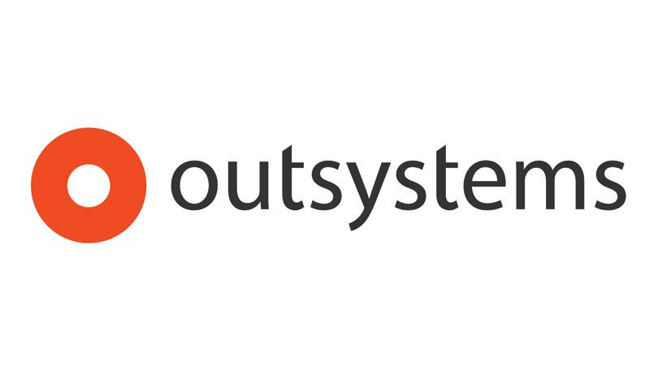
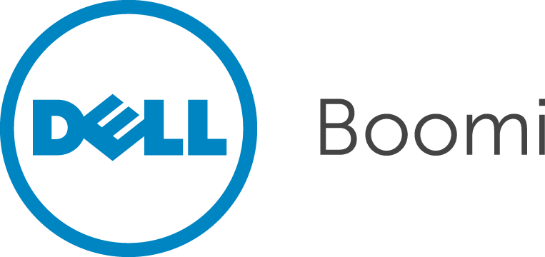
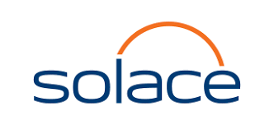
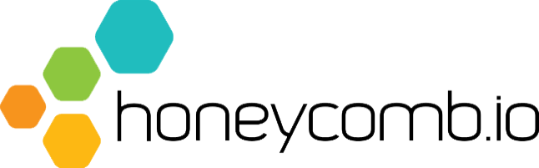
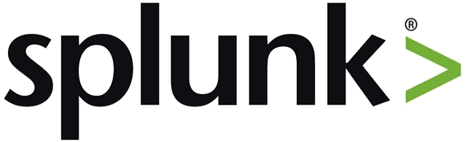
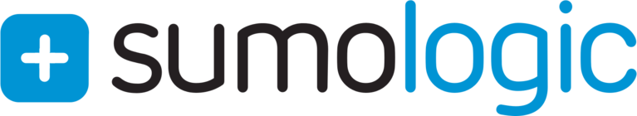
ISV Ecosystem Momentum Drives Platform Advantage
Google Cloud Platform
ETL
SECURITY
DATABASE
ITIL
IAM
IaaS
Microsoft Azure
BPM
TEST
CACHE / LB
SEARCH
NETWORKING
COMMERCE
IDE/CODE
CI / CD
BATCH
MOBILE
API / SOA /
uS / IOT
ANALYTICS
APM
MESSAGING
SIEM / LOG /
AUDIT
Microsoft Azure
Google Cloud Platform
CRM

Slide 24
The Platform Beneath All Abstractions
PCF Overview
Notes:
Keep the following slides introductory - 30,000 ft overview

Slide 25
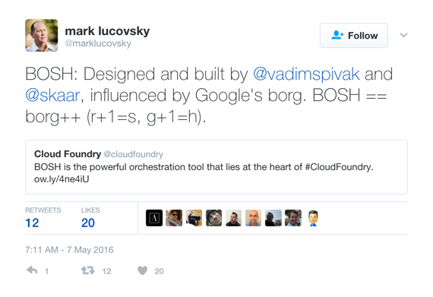
Cloud Foundry BOSH
An open source tool chain for release engineering, deployment, and lifecycle management of large scale distributed services.
Packaging w/ embedded OS
Server provisioning on any IaaS
Software deployment across clusters
Health monitoring (server AND processes)
Service state monitoring
Self-healing w/ Resurrector
Storage management
Rolling upgrades via canaries
Notes:
Let’s talk about the heart of Cloud Foundry and what makes it so flexible, scalable, and secure. Bosh sits at the center of the platform, controlling and monitoring deployments at scale. If you think about the characteristics that make a system resilient and infinitely scalable, you realize that this stuff is hard, regardless of what the platform is.
BOSH was designed to handle reliable and consistent provisioning and monitoring - by doing this right, both time and money are saved. We talk a lot about “day 2 operations” - and this is where BOSH really shines. Consider the recent Intel bugs that were announced - hundreds or thousands of servers across EVERY company require updates in short order. Using Cloud Foundry and BOSH makes this manageable.

Slide 26
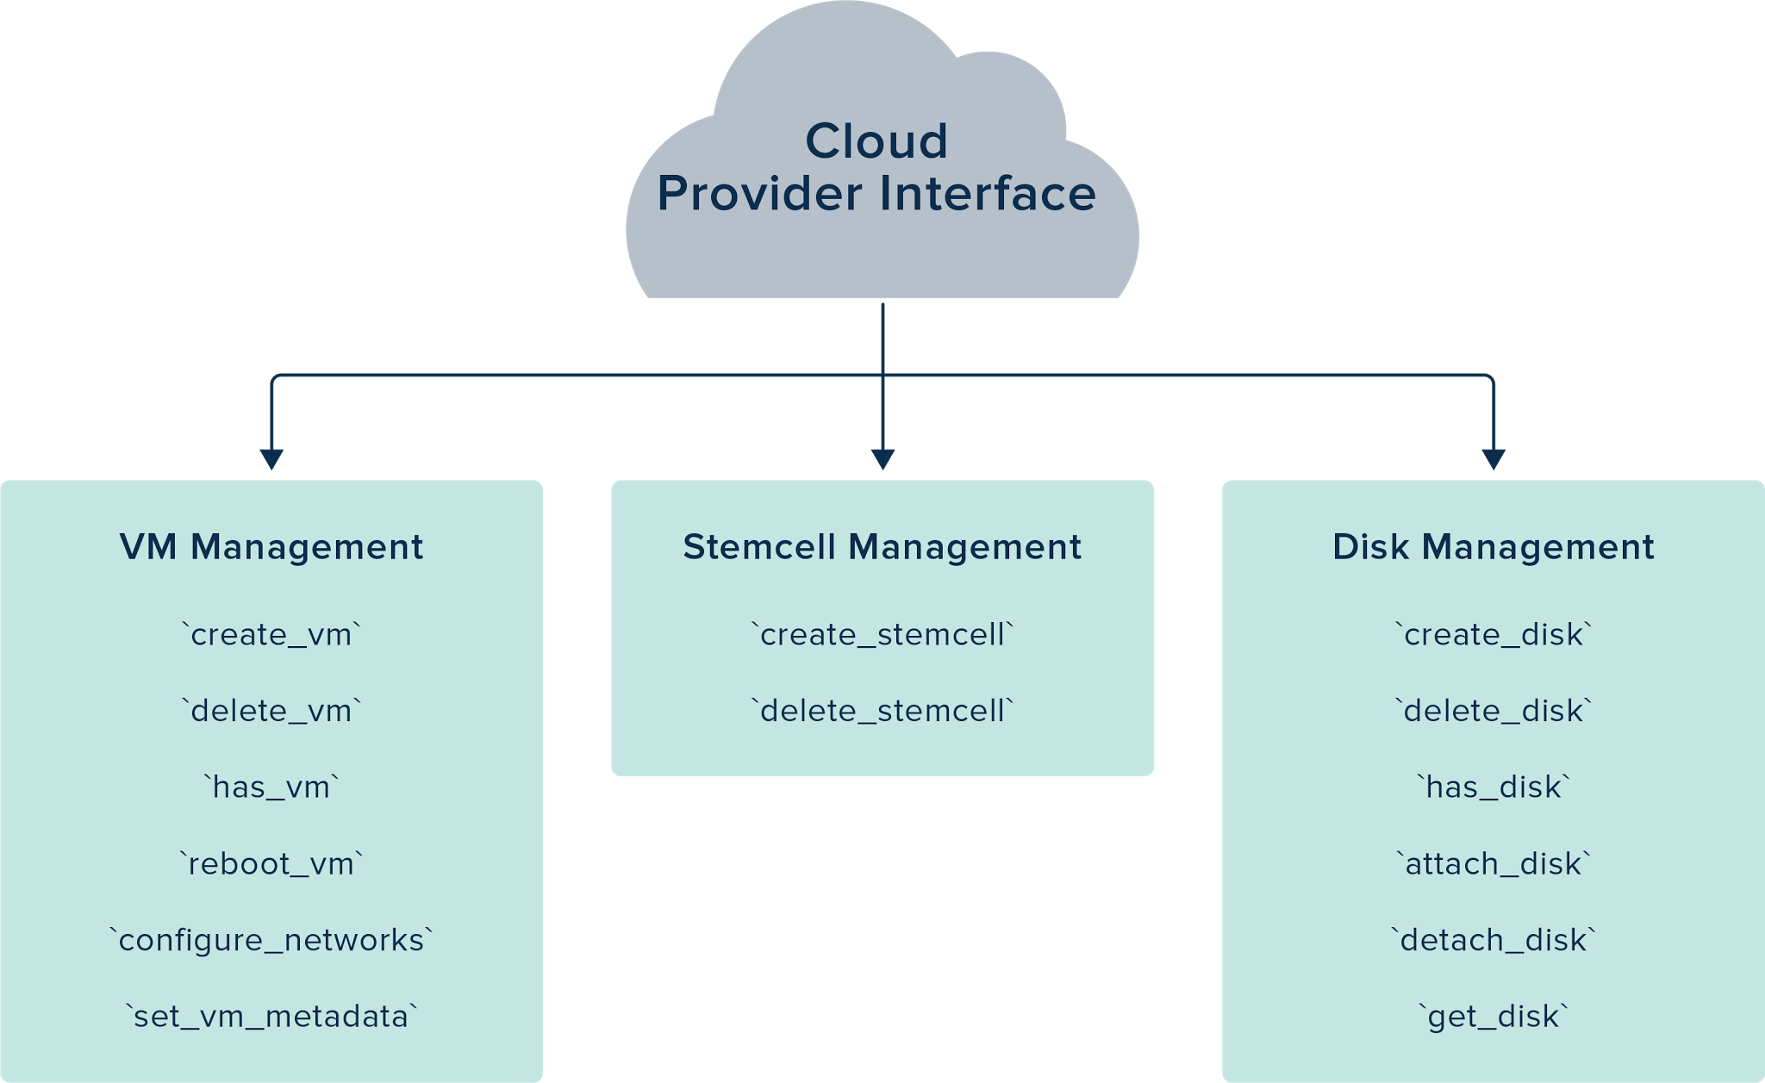
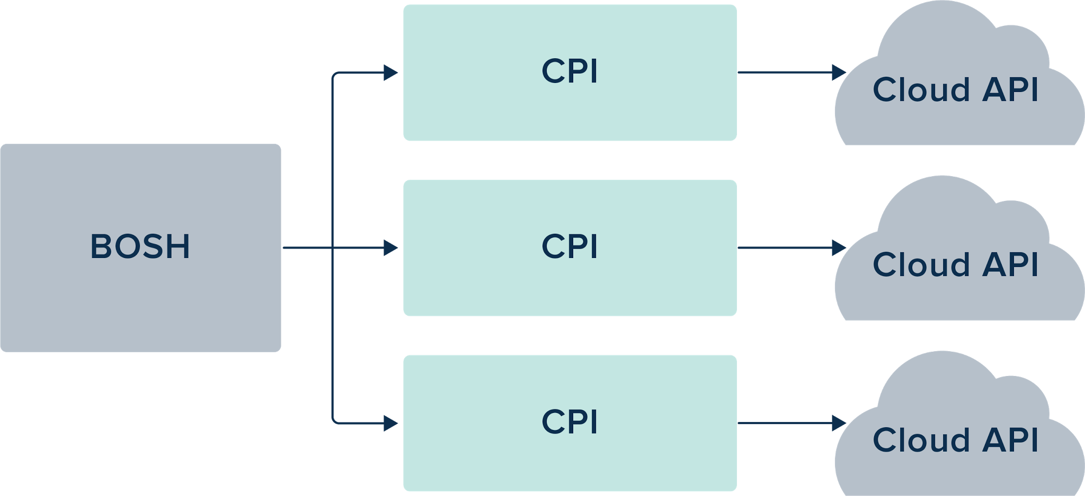
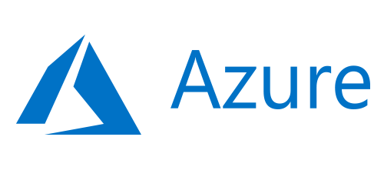
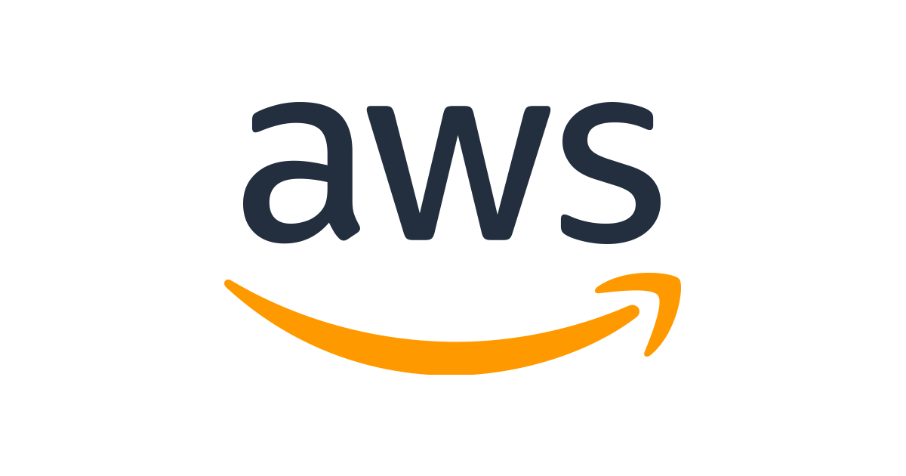
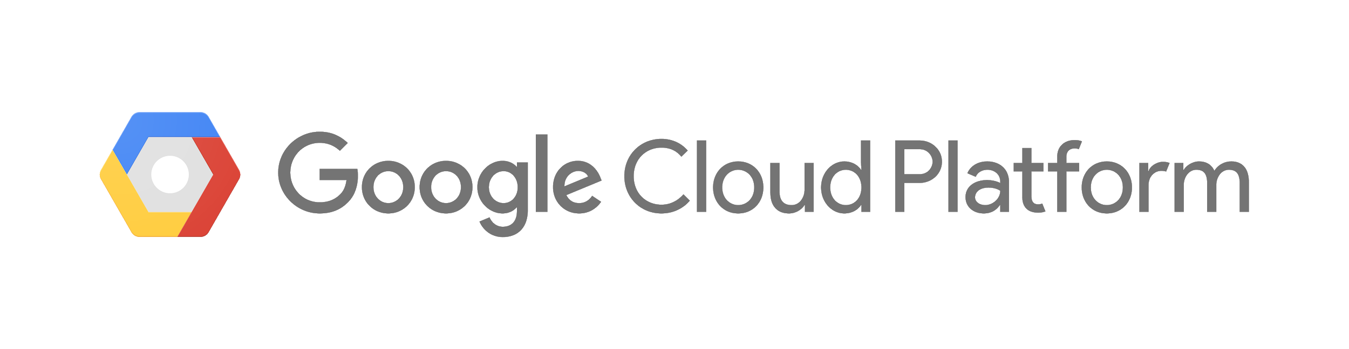
Multi-Cloud with BOSH + CPI
Notes:
The combination of BOSH and the Cloud Provider Interface (CPI) is what enabled multi- and hybrid- cloud. It simply takes the necessary commands to manipulate compute, network, and storage, packages it up by provider, and makes it available to BOSH, which can monitor and manage VM creation. Together, they allow for the same platform and the same apps to run in different clouds, either on premise or in the public cloud. By using a simple CPI against each supported IAAS, we can offer the highest level of flexibility when it comes to cloud vendor selection. Also think of this like an insurance policy against major outages by a cloud provider, as well as against cost increases incurred due to vendor lock-in.

Slide 27

Zero Downtime Updates for OS, CVEs, Patches with BOSH
Notes:
TODO

Slide 28

CredHub Mitigates the Risk of Leaked Credentials
Credentials are the bedrock for trust in the cloud.
CredHub’s goal: deliver cradle-to-grave management of credentials (create, access control, distribution, rotation, logging)
Manages passwords, certificates, ssh keys, RSA keys, and arbitrary values (strings and JSON blobs).
All credentials are encrypted w/a key that rotates (HSM support in OSS & PCF)
CredHub Service Broker for off-platform services
CredHub delivers centralized management of platform and application creds. (Rotation in the future.)
Notes:
-Secure credential management that runs on the BOSH VM.
-Provides a CLI and API to get, set, generate, and securely store credentials.
-CredHub is an OAuth2 resource server that integrates with User Account Authentication (UAA) to provide core authentication and federation capabilities.
-Manages passwords, certificates, ssh keys, RSA keys, and arbitrary values (strings and JSON blobs).

Slide 29

PCF + NSX
App-defined network policies, with container networking
Notes:
PCF now comes equipped with NSX-T networking, which will serve as the networking and security engine behind PCF. In these environments, NSX-T will provide Layer 3 container networking and advanced networking services such as load balancing, micro-segmentation, and more.
For development teams, these integrations mean that they will be able to operate quickly and consume infrastructure as code. Meanwhile, their workflows will remain the same — fast and efficient — because NSX-T will integrate tightly with these application platforms, connecting directly into the Container Networking Interface (CNI), fitting into the existing application development tools that developers are already using. The result is that as developers are deploying code, advanced networking and security services will automatically be provisioned to support their containers and microservices, creating a truly full stack developer cloud.

Slide 30
Key Concepts
Pivotal Application Service

Slide 31
Containers
Developer-Built | Platform-Built
deploy apps as a container, often a docker image | deploy apps as code
developer identifies middleware | platform handles middleware
bring your own language | language support dependent on existing buildpacks
developer is responsible for lifecycle management | platform handles much of the lifecycle management
Use for Elasticsearch, Apache Spark, ISV apps | Use for Java, .NET, Node
Pivotal Cloud Foundry Supports Both Types of Containers
Notes:
We need to make sure we talk about maintainability and security. With developer-built images, we run the risk of those images becoming vulnerable and stale, with no easy way to update middleware and runtimes, such as a JRE or Tomcat by an Operator once vulnerability are discovered. With platform-built containers, that fear goes away since the container can be rebuilt by an Operator with a simple “cf restage” command whenever a new vulnerability is discovered and patched

Slide 32
Pivotal Application Service: Multi-tenancy
Identity Manager (SSO)
Application Manager
Ticket
System
Customer.com
Data
Data
Data
Development
UAT
Production
Access Control
Multi Tenant
Self-Service / Quotas

Slide 33
Pivotal Application Service: Deployment Models
A & B Testing
Blue-Green
Canary
ARCHIVE V1
DEPLOY V2
URL ROUTE V2
URL UN-ROUTE V1
DELETE V1
DEPLOY V2
UAT V2
{ROLLOUT} SCALE V2 | {ROLLBACK} DEBUG V2
URL UN-ROUTE V1
DELETE V1
DEPLOY A | DEPLOY B
URL ROUTE A | URL ROUTE B
ANALYZE METRICS
Notes:
We get asked about deployments all of the time. How do we ensure that applications can be deployed during the daytime, safely? How can we seamlessly transition from one version to the next, while ensuring that all requests are processed? And what’s the best way to update many instances of an application so that we know the updates are working? We’ve got you covered here.
A & B Testing - Deploying a secondary version with slight changes, in order to analyze metrics and choose the most effective version.
Blue-Green - Running 2 copies of the application, with one taking all traffic. The other is re-deployed and tested before the route is changed over, and the other side is updated.
Canary - Rolling out an application slowly to some instances, in order to ensure it performs properly. A decision is made to roll back the changes or continue to the rest of the instances.

Slide 34
In Summary

Slide 35



Slide 36
PCF 2.1 Headlines

Slide 37
PCF 2.1 - Release Headlines
With PAS for Windows, IT leaders can now modernize the .NET and Windows portions of their enterprise application estate. PAS for Windows helps .NET teams increase feature velocity with an elastic runtime that performs many tasks for you. Sysadmins can use the tile to adopt immutable infrastructure practices while running fleets of Windows Servers in their data center.
PAS 2.1 uses a sidecar proxy architecture with Envoy to improve security and stability as traffic flows to and from your apps. This implementation features TLS connections all the way to the application container.
Hardware security modules are often used to store cryptographic keys. They help InfoSec teams comply with industry regulations. Now, you can use PCF and CredHub with HSM devices.
Notes:
Overarching release narrative - what are the key stories that we can tell with this release? What can customers now accomplish more easily that they could not in previous releases?

Slide 38
PCF 2.1 - Speed
.NET developer: PAS for Windows now features Windows Server 2016 containers. This unlocks greater automation in the platform for .NET Framework and .NET Core. [blog]
.NET developer: Steeltoe brings proven microservices patterns to .NET teams. Steeltoe 2.0 now supports ASP.NET Core 2.0, and targets the .NET Standard 2.0. [blog]
Developers: Traditional methods for integrating data between enterprise systems have painful shortcomings. Spring Cloud Data Flow for PCF, a new tile, is a complete toolkit for building data integration and processing pipelines, helps you overcome these challenges. Create pipelines with Spring Boot apps, and realize greater flexibility in data processing scenarios. [blog]

Slide 39
PCF 2.1 - Stability
Operator: Updating floating stemcells is easier with the new Stemcell Library. This new tool reduces the impact of unforeseen changes when “bumping” a floating stemcell.
Operator: PCF Healthwatch now includes alerts, to proactively notify you when the platform exceeds key performance and scaling indicators. This helps you proactively address potential issues before they occur. Alerts can be sent to Slack, via email, or by webhook targets.
Operator: PAS 2.1 improves routing resiliency and consistency. PAS components will ignore the TTL of app routes, keeping your apps available during failures in the routing control plane. Further, TLS is used to protect against misrouting. [docs]

Slide 40
PCF 2.1 - Scalability
App Operator: App Autoscaler supports two new rule types: container memory and RabbitMQ Message queue depth. This gives you more ways to automatically scale in and out, and keep your apps online, serving traffic.
App Operator: PAS for Windows now works with App Autoscaler. Apps that use the Hosted Web Core framework can now automatically scale-in and scale-out according to custom rules.
.NET Developer: PAS for Windows now runs Windows Server containers. This gives developers an automated platform that easily scales to handle variable workloads. [blog]

Slide 41
PCF 2.1 - Security
InfoSec: Need to use an HSM? That’s now supported by PCF. BOSH CredHub, the secrets management repository for the platform, uses the SafeNet Luna Network HSM to encrypt and decrypt data. PAS can integrate with HSMs to encrypt service credentials as well.
InfoSec: PAS components now encrypt traffic to application containers via TLS. This gives you greater encryption for data in transit.

Slide 42
Pivotal Application Service 2.1
Windows 2016 containers
TLS connections to the application container (via Envoy)
Spring Cloud Data Flow for PCF
PCF Healthwatch includes events
App Autoscaler: new rule types & CLI plug-in
IaaS flexibility with custom vm_extensions
Service instance sharing [beta]
Platform-native service discovery for all frameworks [beta]
New features
Notes:
Here are some new features of the latest major version of PAS. We should note that many of these are a direct result of customer feedback and changing industry trends. Here are a few:
Windows 2016 containers
TLS connections to the application container (via Envoy)
Spring Cloud Data Flow for PCF
PCF Healthwatch includes events
App Autoscaler: new rule types & CLI plug-in
IaaS flexibility with custom vm_extensions
Service instance sharing [beta]
Platform-native service discovery for all frameworks [beta]
As you can see, the main feature areas for PAS 2.0 continue to evolve.

Slide 43
PAS for Windows
Windows 2016 Runtime Tile
Support for Windows Server Core stemcells
Unlocks the potential for the newest PCF platform features for an on-par experience with Linux applications: CPU + network limits, CPU-based autoscaling, CredHub encrypted service creds, Diego SSH (i.e. cf ssh)
Made available via a new OpsManager tile for a smooth upgrade experience from 2012R2 to 2016
Includes Windows Server Containers offered on Windows Server 2016
Notes:
There has always been a divide been the Windows and Linux camps, which has traditionally resulted in organizations having to support one or both platforms, in completely different ways. Pivotal has taken the opposite tact - to embrace Windows development and runtime as a first-class citizen. The offering of a Windows tile, fully supported, managed by BOSH, and offering feature parity with Linux rounds out the platform as complete. Now the same management and monitoring of applications running in the Linux world is available to Windows, and our team will continue to enhance and deliver on the promise of developer choice, platform, and language independence.

Slide 44
Spring Cloud Data Flow for PCF
OSS SCDF 1.3
UAA Integration
cf CLI plugins simplify service instance management & aggregate app telemetry
Simple service instance setup (via Service Broker)
Works with PCF data tiles (MySQL, Redis, RabbitMQ)
Works with public cloud data services (Azure SQL Database, GCP’s BigQuery), plus on-prem sources
Build Flexible Data Pipelines
Notes:
https://content.pivotal.io/blog/building-flexible-data-pipelines-with-spring-cloud-data-flow-for-pcf

Slide 45

Pivotal Cloud Cache 1.3
WAN Replication
Notes:
Other highlights:
Cross DC data sharing in PCC BOSH can rotate IPs without rebinding Eliminate use of Ops Manager IPAM Whitelist gfsh commands which are allowed to avoid snowflakes PCC running on PWS-E Integrate memory usage statistics to OpsManager report Elastic Runtime can drop its hard dependency on Consul in favor of BOSH DNS Ensure compliance with new UAA get/post

